Slide 1
Online Job Portal
Proposal Defense Presentation On:
Group Members:
Gaurav Thapa
Sugam Acharya
Ayush Bholan

Slide 2

Table of contents
01
02
03
04
05
06
Introduction
Problem Statement
Objectives
Target Audience
Functional Requirements
Technical Requirements

Slide 3


Introduction:
Our online job portal simplifies job searching and recruitment by connecting job seekers and employers through a user-friendly platform, making the hiring process faster and more efficient.

Slide 4
Problem Statement:
Scattered Job Hunt:
Job seekers juggle multiple platforms, missing out on opportunities.
Time-Draining Recruitment:
Manual processes slow employers down, leading to delays and inefficiencies.
Access barriers:
Geographic and time limits keep opportunities out of reach for many.
Silent Gaps:
Poor communication means missed connections and delayed updates.
The Need?
A streamlined, centralized job portal to bring seekers and employers together—efficiently and seamlessly.

Slide 5
Objectives:
Build a user-friendly platform that connects job seekers and employers.
Enhance recruitment with resume management, analytics, and real-time notifications.

Slide 6
Target Audience:
Job Seekers
Employers
Recruitment Professionals
Students
Entry-level professionals
Experienced job seekers
Part-time Workers
Small Businesses
Large Corporations
Startups
Recruitment Agencies
HR managers
Recruitment Officers
Talent Acquisition Specialists
Freelancers & Contractors:
Independent Professionals
Consultants
Remote Workers

Slide 7
Functional Requirements:
Job Posting and Search
User Roles and Access Control
Employers can post new job listings, including job title, description, salary, location, and requirements.
Job seekers can search for jobs by category, location, and keywords.
Admin:
Manage User Accounts
Monitor Job listings
Employer:
Post Job Listings
View and manage applications.
Accept or reject job applicants.
Send notifications to job seekers.
Employee:
Create and update resume.
Search and apply for jobs.
Receive notifications about job openings.
Application Management
Job seekers can apply for jobs directly through the platform.
Employers can view, review, and filter applications.
Employers can send email and notifications to applicants.

Slide 8
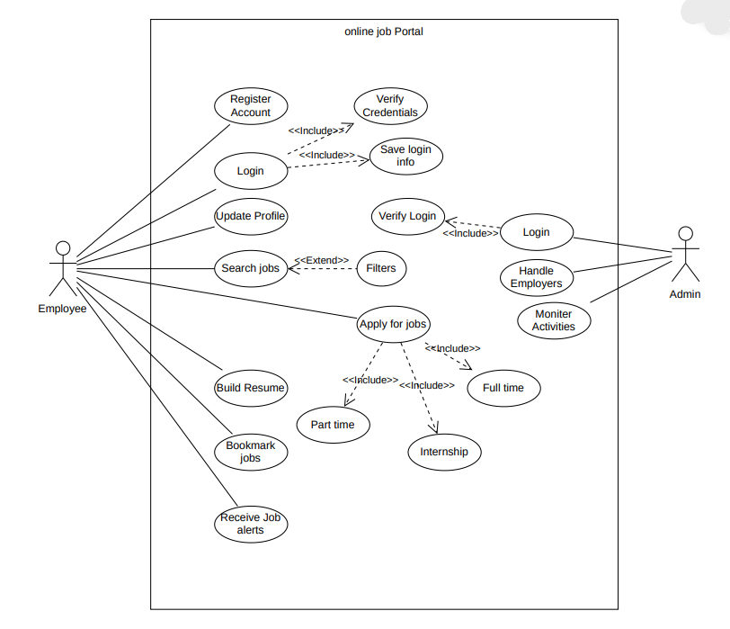
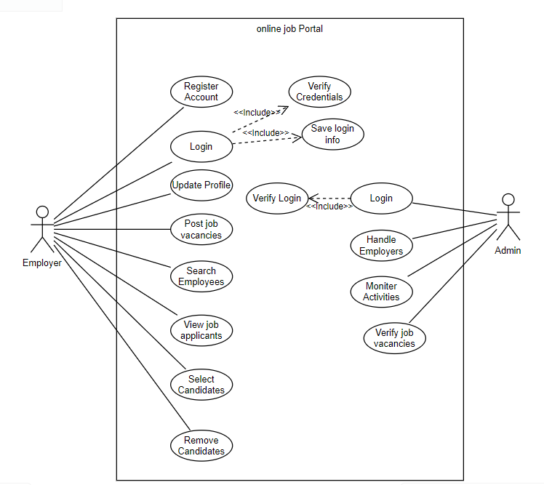
Technical Requirements: Use Case Diagrams

Slide 9
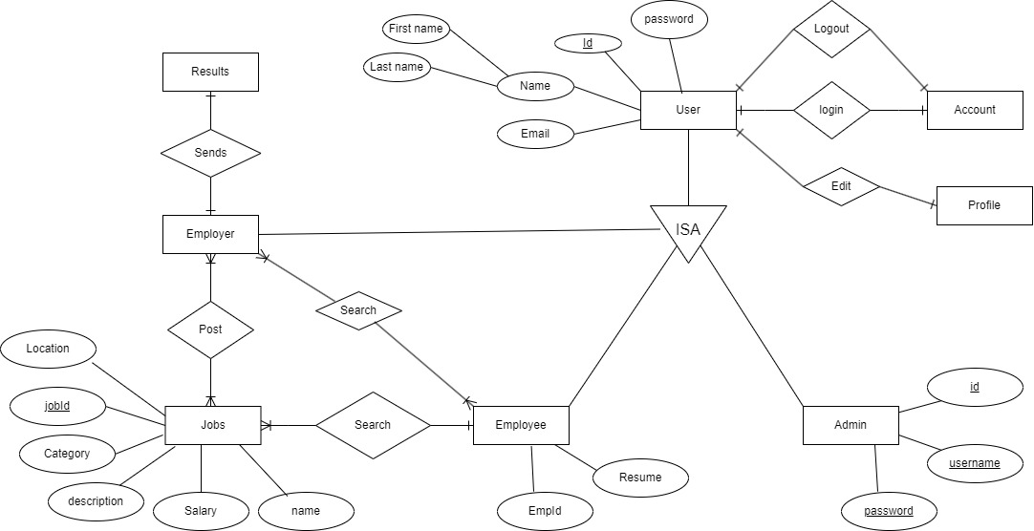
Technical Requirements: ER Diagram

Slide 10
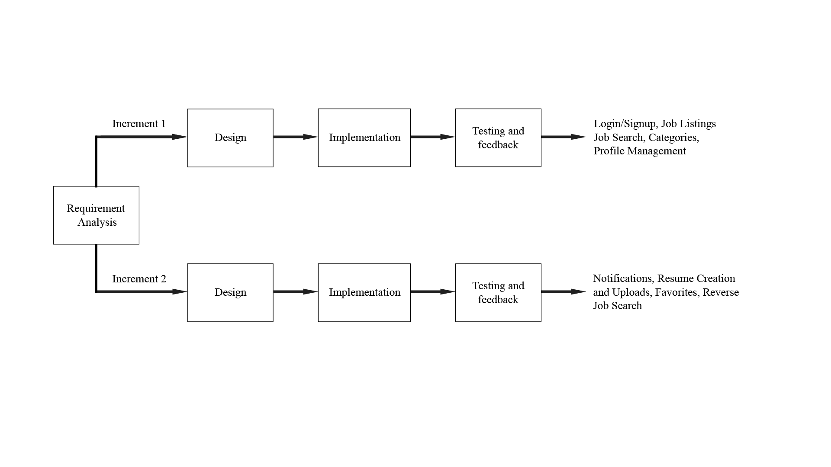
Methodology: Incremental Model

Slide 11
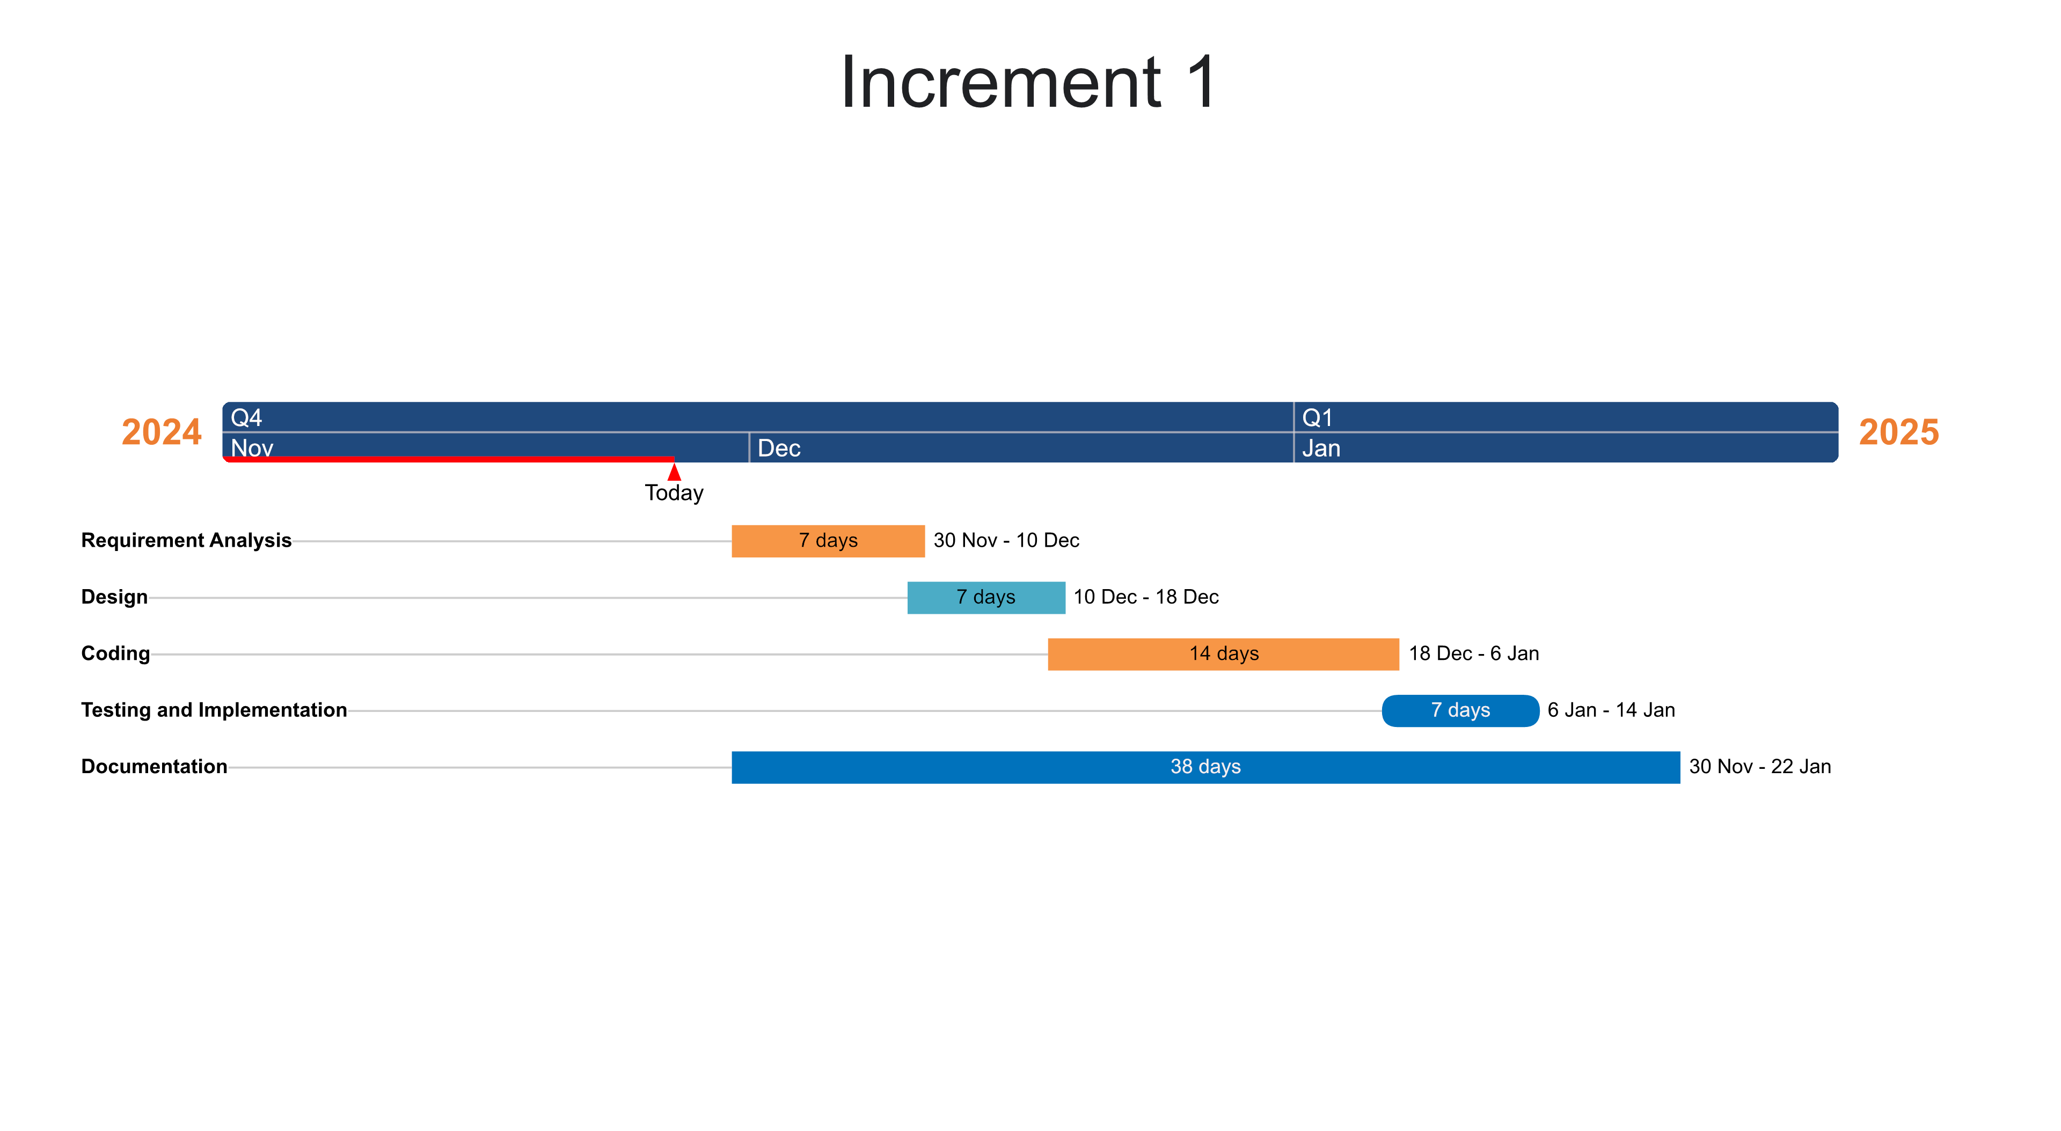
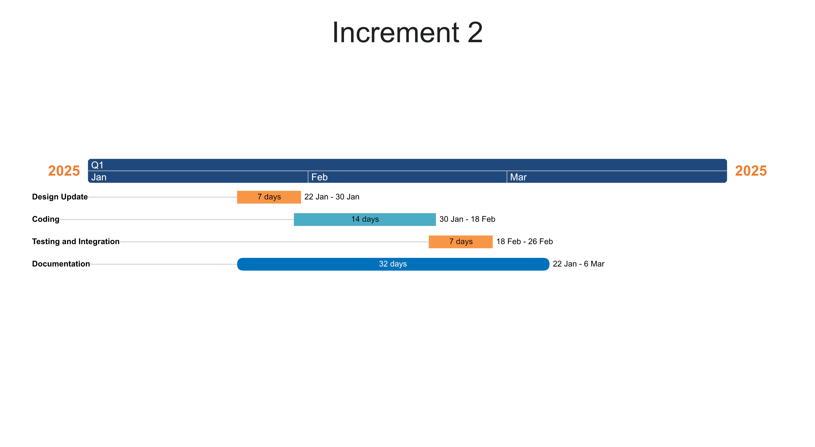
Estimated Timeline:
1st Increment
2nd Increment

Slide 12
Used Technology:
TOOLS | PURPOSE
HTML, CSS , JavaScript | Frontend Development
Python Django | Backend Development
PostgreSQL | Database Server
Adobe Illustrator | Designing UI
StarUML | Drawing Graphics

Slide 13
Task Division
Team Member | Roles
Gaurav Thapa | Frontend Development, Documentation
Ayush Bholan | Documentation, System Design
Sugam Acharya | Backend Development

Slide 14
Thanks!

